Slide 1
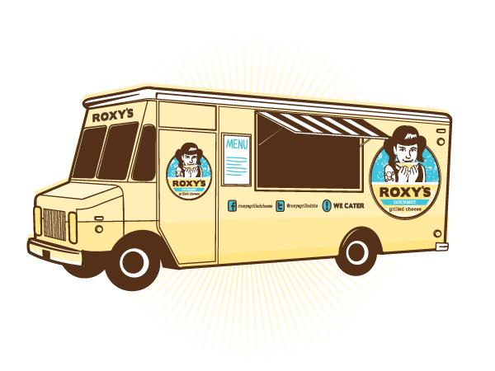
SOCIAL MEDIA FOR FOOD TRUCKS: 101
James DiSabatino
Founder / Roxy's Grilled Cheese

Slide 2
AGENDA
What is Social Media?
Why Is It Important?
Generation "C"
Social Media + Food Truck Movement
Tips/Strategies

Slide 3
WHAT IS SOCIAL MEDIA?
People create, share, exchange information online
Integral part of internet marketing
One facet of Inbound Marketing

Slide 4
TYPES OF MARKETING
Outbound Marketing
Telemarketing
Tradeshows
Print advertising
Direct Mail
- Antiquated
- Aggressive
- About finding customers
Inbound Marketing
Social Media
SEO
Blogs
Youtube Videos
- Disruptive
- Progressive
- About customers finding you

Slide 5
WHO IS USING IT?
96% of 18-35 year olds use social media in one way or another.
76% of 18-35 year olds drink orange juice*
*I may or may have not made this statistic up.
FACEBOOK | OVER 1B USERS
TWITTER | 500M
LINKEDIN | 300M
TUMBLR | 150M
INSTAGRAM | 90M
SPOTIFY | 33M
PINTEREST | 11M

Slide 6
WHY IS SOCIAL MEDIA IMPORTANT?
The new frontier in customer engagement
Consumers are immune to traditional media
Consumers want companies to use social media as a way to:
  Be transparent and authentic
  Listen to ideas
  Engage in conversations
  Solve problems
Food trucks are serving a new generation of consumers

Slide 7
GENERATION C:
THE CONNECTED CONSUMER
First generation defined not by age, but by behavior
Embrace a digital lifestyle
Meet on the internet (forums, networks)
Share content
Influence others
Engage you

Slide 8
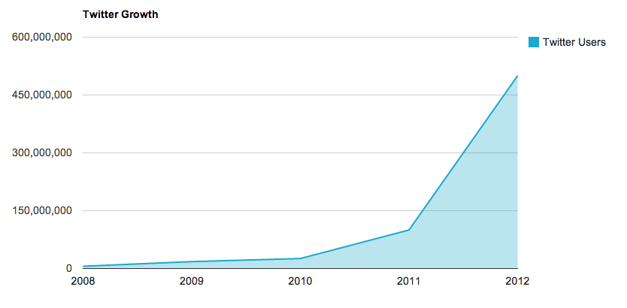
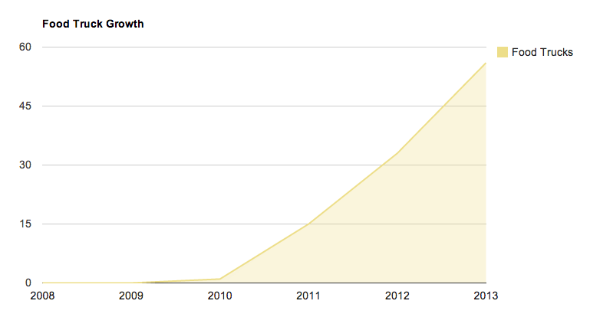
RISE OF SOCIAL MEDIA AND FOOD TRUCKS
The exponential growth between Twitter users and Boston Food Trucks from 2008-Present is eerily similar.
TWITTER
FOOD TRUCKS

Slide 9
RISE OF SOCIAL MEDIA AND FOOD TRUCKS
Food trucks = first in culinary world to majorly adopt this open communication platform
  Twitter and LA food trucks circa 2008
Small corporate structure meant direct online relationships between owners and customers
Generation “C” is a generation that demands transparency, listens, offers insight, and looks for help
The Food Truck movement organically represents all of the virtues generation “c” stands for

Slide 10
SOCIAL MEDIA TIPS AND STRATEGIES
Find your voice
Elicit responses
  And RESPOND!
Allocate Time
Photos
Do not "half-ass" it
Quality over quantity
Social Media is not a saving grace

Slide 11
KEEP IN TOUCH!
james@roxysgrilledcheese.com
@ JamesDiSabatino
@RoxysGrilledChz

